Slide 1
GRAPHS

Slide 2
AVL PRACTICE QUESTION
14, 17, 11, 7, 53, 4, 13, 12, 8
Now remove 53, 11, 8

Slide 3
Introduction
G= (V,E) //graph representation
Properties
Adjacent
Neighborhood
Degree & (handshaking lemma)

Slide 4
Representation of graph
Adjacency list
Adjacency matrix

Slide 5
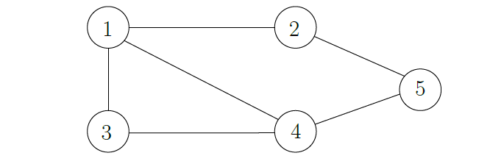
Example

Slide 6
Paths and graph connectivity
Length of a path: |Path(a,b)| = |{a,…,b}|-1
Reachability and connectivity
Trees, forest and cycles

Slide 7
Trees and forests
Tree: If a graph is connected and it contains no cycles, it is called a tree.
Forest: If the graph does not contain any cycles, but is not connected, it is called a forest.
The connected components of a forest are trees

Slide 8
Digraphs
adjacency
Neighborhood (in/out neighbor)
Degree (in/out degree)
DAG : used in topological sort

Slide 9
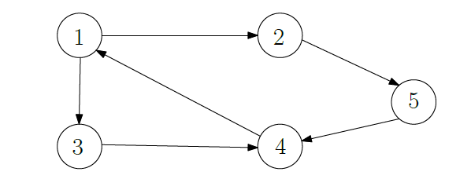
Example

Slide 10
Strongly, weakly and simply connected graphs
A strongly connected graph is one where there exists a path from every vertex to every other vertex.
A connected graph has a weaker constraint, in that it requires either a path from a to b or a path from b to a for all vertices.
Weakly connected directional graph will give a connected undirected graph if its edges are replaced with undirected edges

Slide 11
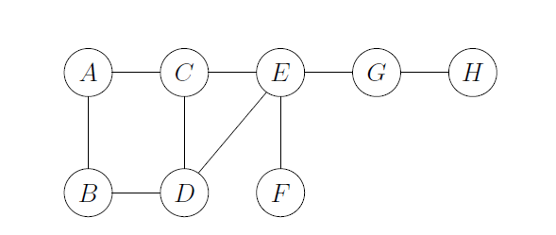
BFS AND DFS EXAMPLE

